Slide 1

Ulster Lending Transformation Programme
Commercial & Private Banking
Ulster ROI - UBR1 Test Strategy
Reviewed
Version: 0.8
Version updated: 19.08.2019
Guna / Shazia
Information Classification: Confidential

Slide 2

Contents
4.0 Functional Testing (From Slide 36)
Test Approach
Functional Automation Testing
E2E Testing – Integrations
Regression Testing
5.0 Non Functional Testing (From Slide 43)
Summary
Performance Testing
OAT Testing
Security & Pen Testing
Accessibility Testing
1.0 Testing High Level (From Slide 3)
Document Contextual Overview
Team Structure
Scrum Test Approach
Roles & Responsibilities
Test Accountabilities
2.0 UBR1 Risk Views (From Slide 11)
Platform Introduction
Operational Risks to be Mitigated
Changes driving risk levels
Test Approach to mitigate risks
Mitigation success indicators
Test Strategy – High Level
Test Environment
3.0 The wordy stuff (From Slide 28)
Testing Governance
Risk Management
Quality Standards
Release & Story Standards
Tools Overview
Data Process
Defect Management Process

Slide 3


1.0 Testing High Level
Document Contextual Overview
Team Structure
Scrum Test Approach
Roles & Responsibilities
Test Accountabilities
Test Strategy – High Level
Test Environment

Slide 4

Introduction
Introduction
The following Test Strategy summarises how testing will be performed across releases for the Ulster Project delivery. The Test Strategy is subordinate to the RBS Test Policy and provides a simple framework from which Ulster project will deliver testing against.
The Test Strategy will:
Outline how Operational Risk will be understood to drive the delivery of value-adding testing with associated products
Outline the governance and compliance approach including the practical application of the RBS Test Policy Principles
Outline how testing will be organised across the platform
Outline the key testing expectations for key roles across the platforms
Outline the end to end testing life cycle for each release
Outline environment and associated components needed to deliver testing

Slide 5
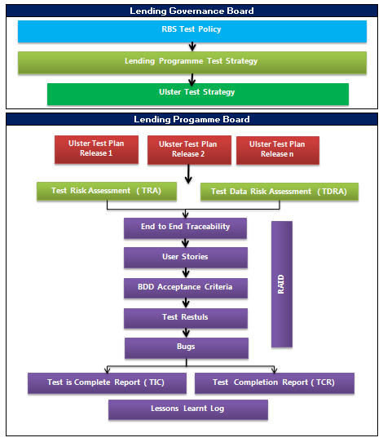

Governance Model

Slide 6

Document Distribution
Issue Date | Author | Updates | Version | Status | To Whom
17/07/2019 | Shazia | Draft Document | 0.1 | Draft | Rob Hornett
30/07/2019 | Shazia | Reviewed from Rob | 0.5 | Reviewed | Rob Hornett
13/08/2019 | Guna Subramanian | Enhanced the slides to fit for Ulster | 0.6 | Reviewed | Delivery Approvers
16/08/2019 | Guna Subramanian | Reviewed the slides with Jag | 0.7 | Reviewed | Delivery Approvers
19/08/2019 | Guna Subramanian | Updated the OAT Decision | 0.8 | Reviewed | Governance & Final
Review/ Approval | To Whom | Role | Status
Reviewers | Guna Subramanian Srikanth Sonti Anup Chanchlani Sumit Sharma Jonathan Coward Peter Henham Adam Tait Rob Hornett | Senior Digital Test Manager CPB Design Lead Designer Scrum Master Technology implementation Business Analyst Project Manager Head of Testing | Rob – Reviewed ( incorporated the changes) Guna – Reviewed Sri – Reviewed Business Team ( walkthrough provided) Jag ( Walkthrough provided)
Delivery Approvers | Jayanthi Manikandan Susan Meehan / Brain Casey Jag Gill Rob Hornett | Accredited Test Manager (ATM) Product Owner(s) Release Manager Head of Testing | Jayanthi – Signed Off Brain – Signed Off Jag – Signed Off Rob – Signed Off
Governance and final Approval | Governance Forum: Susan Meehan Dan Hill John Hickey Tony Niven | Ulster CAO Head of Lending Change Head of Lending Technology Head of Lending PMO | Dan Hill – Signed Off

Slide 7

Document Contextual Overview
This diagram symbolises that quality and risk are addressed from conception to delivery. Overall goal is to focus on optimisation and removal of waste to increase quality & reduce risk
UBR 2
UBR- 1
Hybrid
To
Risk
Quality
Projects
Requirements
Scrum
Kanban
Testing
Development
Architecture
Customer
Business
Functional
Non-Functional
Risk
Quality
Identify
Efficiency
Reduce
Delivery
Predictability
Compliant
Consistency
Traceability
Monitor

Slide 8
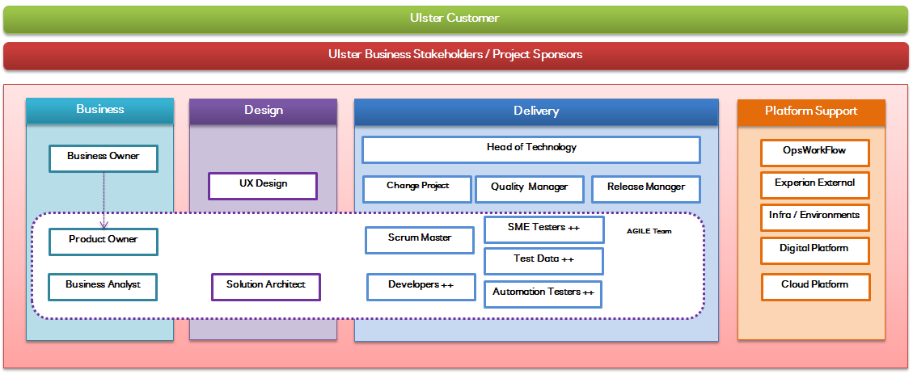
Team Structure

Slide 9
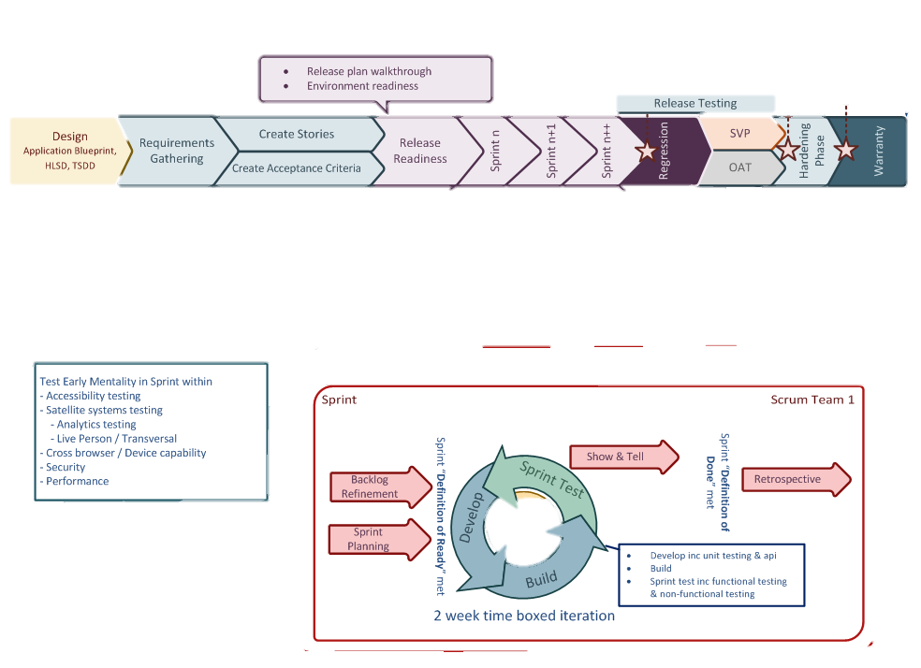
Scrum Test Approach – High Level

Slide 10
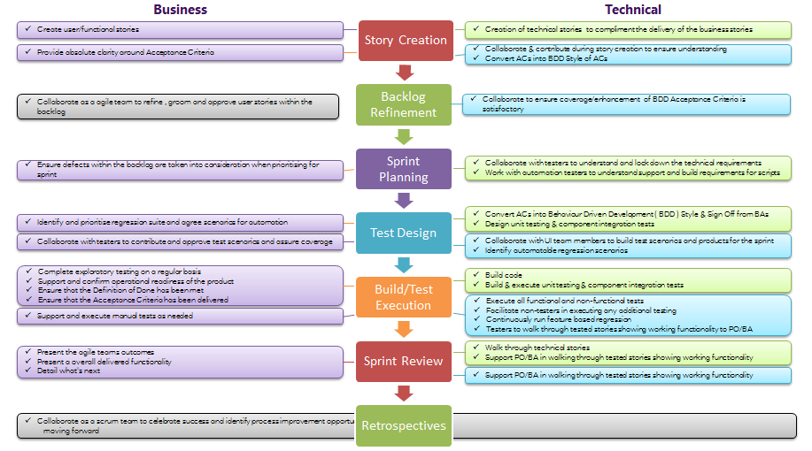
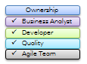
Roles & Responsibilities of AGILE Team

Slide 11
2.0 UBR1 Risks View
Introduction to Platform
Operational Risks to be Mitigated
Changes driving risk levels
Test Approach to mitigate risks
Mitigation success indicators

Slide 12
Platform Introduction
The current Ulster ROI proposition involves:
An online application form on UBROI unsecured brochure-ware which allow non personal customers to request a loan and overdraft
Customer applications (including data on customer details, product, borrowing amount and term) are processed by a UBB Direct team using the BAPS system
The Commercial Lending Domain will Implement a new Ulster Bank Business Direct Customer Lending SPA, which will provide an end to end self-serve digital journey allowing customers to:
Discover and apply for an applicable Lending product, based on their needs, with certainty around the cost
Be provided with a real time and automatic credit decision
Be provided with an automated Legal Execution aspect of the Post-Credit Decision process, with documents being produced and signed digitally
Have their Lending Product opened and funded by the next working day, via an automated hand off to the Ulster Fulfilment team in Belfast, who will manually book and fulfil the lending applications by keying them into the BAPS system
Be supported by a member of the Ulster Business Direct team in Galway, via an “Assisted journey”, for any exceptions that cannot be progressed by the customer

Slide 13
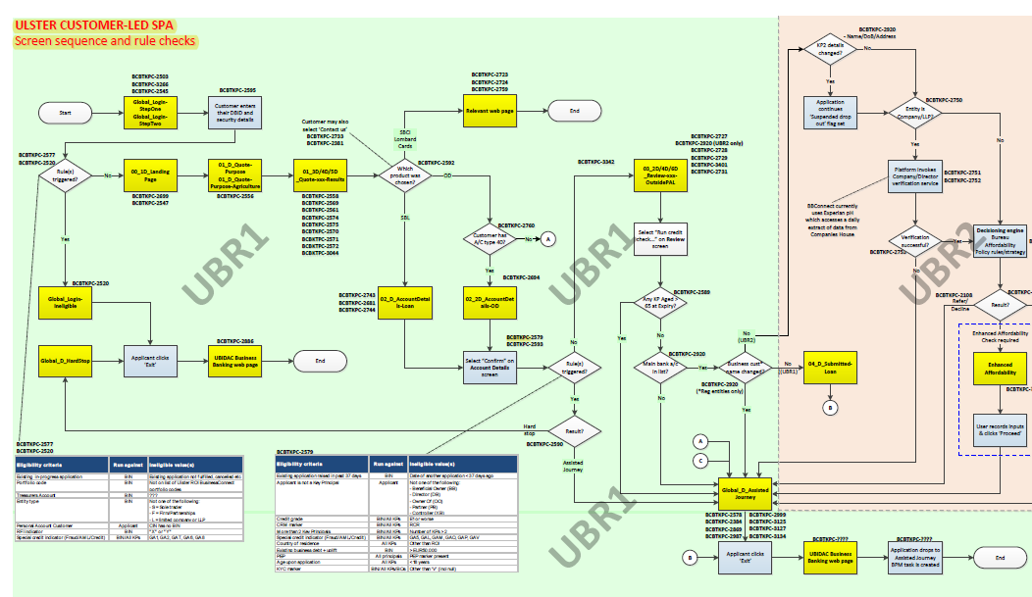
Logical Solution Design

Slide 14
Business Risk Assessment Profile – Ulster UBR 1 (1of 3)
Potential Operational Risk to be Mitigated | Risk Level From Change | Change driving risk level | Test Approach to Mitigate | Mitigation Success Indicators | Test Phase | Expected Residual Risk Rating after testing
1.1 External Security Vulnerability | H | new Ulster URL Ping Moving to Edinburgh MS services upgrading to cloud New Gateway Service for Ulster communicating using JWT token | Security / Penetration Testing phase. External testers to run Primary and Final cycles of testing. | No Major security flaws o/s in implementation | Penetration Testing | Zero
1.2 Internal Bank User Access breach | L | Salesforce Security Controls Permission for Internal Users. IAM Security for External Customers. Customer is directed to a secure channel Refer to Slide 22 HLSDPlus for policy rules on security | Functional testing/ NFR | Zero major defects which enable unauthorised people to access information | Functional testing | Zero
1.3 Internal Bank or Customer Authorisation breach | N/A | SalesForce authentication Refer to Slide 22 HLSDPlus for policy rules on security | Functional/NFR | Zero tolerance | N/A | N/A
2.1 Financial Calculations are not correct | H | Repayment calculations are existing and ODM pricing will be new for this release | Functional | Zero major defects which enable unauthorised people to access information | Functional testing | Zero
2.2 Business Rules are not correct or invoked correctly | H | Enhanced Drools rules basedon the BBConnect UK. Lending Finder is extended for Ulster | Functional | Zero tolerance | N/A | N/A
2.3 Critical calculations or decisions are based upon stale data | M | All DBs are updated daily….reference data is refreshed regularly- data will be requested for specific calculations Autosys job will test expired applications | Functional | Zero tolerance | N/A | N/A
2.4 Reference data has been loaded or referenced incorrectly | H | Reference table changes / not loaded properly will be tested as part of functional testing. Database will be shared with Digital Platform | Functional testing | Zero major defects which enable unauthorised people to access information | Functional testing | Zero
3.1 Ulster Tool does not fully integrate with other business processes | H | Sales Force new integration CDE and core are existing integrations with adaptions for Ulster | Integration testing | Zero tolerance | UAT | Zero
3.2 The Ulster tool leaves the user confused on next steps | M | Digital Customer journey look and feel customised for Ulster | User walkthroughs/show and tell, UAT, Usability testing | Business are happy to approve | UAT / Usability Testing | Zero
3.3 Accessibility requirements not met | M | Digital Customer journey look and feel customised for Ulster | AXE will be deployed into browser for the first level Accessibility will be performed while Functional testing Both Development Team and an External Test Team (Blazie) will run accessibility tests against the code using applicable test tools. | Accissibility compliant | Accessibility Testing | L
3.4 The application is sluggish, slow or erratically working | M | NFR to define testing | Performance Testing | Tolerance as defined in NFR. Current Ulster is a manual process and digital should show improvement | Performance Testing | Zero
 | M | NFR to define testing | Performance Testing | Tolerance as defined in NFR. Current Ulster is a manual process and digital should show improvement

Slide 15
Business Risk Assessment Profile – Ulster UBR 1 (2of 3)
Potential Operational Risk to be Mitigated | Risk Level From Change | Change driving risk level | Test Approach to Mitigate | Mitigation Success Indicators | Test Phase | Expected Residual Risk Rating after testing
4.1 Application functionality from previous releases no longer works properly | H | All current Tier3/4 MS will be reused, Pricing ODM service will be changed | Regression BBConnect UK, Digital, ODM, Lombard regression | Regression completes successfully | Sprint + E2E | Zero
4.2 The new functional scope does not work properly | H | This release introduces a new online Lending application for Ulster | Sprint and E2E Functional Testing of in scope functional requirements (User Stories) | No outstanding Severity 1 or 2 level defects. | Sprint + E2E | L
5.1 The business change lending Ulster policy process or thresholds | M | Process must be in place for Business to update technology when necessary | Legal text needs to be verified by Business | Business has this oultlined | N/A | N/A
5.2 The business change pricing sensitive information | L | Process in place to update Technology by Business | N/A | Business has this outlined | Business Process | Zero
5.3 The business change permissions of data access or authorisations | N/A | Process in place to update by technology by Business | N/A | Business has this outlined | Business Process | Zero
5.4 The business change the organisational or support model | N/A | Process in place to update technology by Business | N/A | N/A | Business Process | N/A
6.1 ‘Near neighbour’ non-Ulster system impacts application | N/A | SalesForce, CDE, Core integrate with Ulster. Process in place to update lending technology | Line of communication with support teams | Line of communication with support teams | Business Process | L
6.2 Ulster application makes changes impacting non-Ulster systems | N/A | Process in place to update near neighbours by Lending Technology | Line of communication with support teams | Line of communication with support teams | N/A | N/A
6.3 ‘near neighbour -1’ system impacts Ulster | N/A | Process in place to update near neighbours by Lending Technology | N/A | N/A | N/A | N/A
6.4 Golden Source data is not as expected | M | Golden source defined and will be tested | Data team will select from source data | Data team will select from source data | N/A | N/A

Slide 16
Business Risk Assessment Profile – Ulster UBR 1 (3 of 3)
Potential Operational Risk to be Mitigated | Risk Level From Change | Change driving risk level | Test Approach to Mitigate | Mitigation Success Indicators | Test Phase | Expected Residual Risk Rating after testing
7.1 Changes reduce Operational Resilience | M | Would the introduction of Ulster Digital Lending Journey impact the resilience of the Ulster Application | Operational Acceptance Testing. | De-Scoped | OAT | L
7.2 Changes reduce recoverability | M | Data must not be lost during an outage to Ulster application. |  |  | OAT | L
7.3 Changes reduce service integrity | M | The Ulster Digital Lending Journey needs to meet the required viewing and transaction functionality availability times if there are planned outages for Ulster, SalesForce application or Ulster Journey, these must be communicated ahead ahead of these times |  |  | OAT | L
7.4 Changes reduce capacity | M | There are capacity requirements in terms of data volumes for internal users, customers, facilities and user locations. |  |  | OAT | L
7.5 Changes reduce manageability | M | There is a need to for Ulster Digital Lending Journey Data to be retained, archived, and protected, |  |  | OAT | L
7.6 Changes reduce supportability | M | The release introduces a brand new external facing Digital Application that IT Support will need to support . |  |  | OAT | L
7.7 Changes reduce security | M | There are security requirements relating to customers, staff, support team(s) and Inquiry API users and what data they are able to access / view. | Security / Penetration Testing | No Major security flaws o/s in implementation | Penetration Testing | Zero

Slide 17
Ulster – Functional Test Strategy ( 1 of 2)
Ulster Functional Testing - Overview of Test Approach (1 of 2)
Test Phase | Cycle | What is done | Who is involved | When | Method (How) | Risk Mitigation (why) | Test Env
User Stories | Sprint | BDD Creation Automation of GUI Step definitions ODM testing and targeted regression Exploratory Testing Test Data mining/verification Integration tests early where possible Walkthrough Continuous run of automation scripts built | Testers Product Owners | In Sprint | BDD- gherkin plug in GUI Automation- Selenium web driver Intellij Java Development Test Harness ODM Development | Early preparation and testing to identify bugs and blockers early Code not broken from earlier deployments Requirements met as timelines move on | QA/Dev
 | Last 2 Weeks | Automation | Automation execution | End of sprint 10 | Automated scripts | No broken code from earlier sprints. | QA/NFTe
Release Regression | Sprint | Automation Exploratory testing | Testers | End of each sprint | Manual and automation | No broken code from earlier deployment | QA
 | E2E | Automation pack should be ready for continuous testing. Ideally using Team City |  |  |  |  | QA/NFTe
 | Last 2 Weeks
Production Regression | UAT | Stakeholders expectations met | Ulster business users from: Product Owners | Last month | UAT Access | User expectations not met. Legal and business issues picked up late | QA
 | E2E | E2E Testing Regression Testing of all systems maximising the use of automated packs ODM Regression testing Full integration test with SalesForce including Autosys expiring incomplete applications | Automation Tester SME Exploratory testing | Once E2E journey works with full integration. End of Sprint | Automation Suite Manual exploratory testing | Regression to ensure no impact to other journeys | QA/NFTe

Slide 18
Ulster – Functional Test Strategy ( 2 of 2)
Ulster Functional Testing - Overview of Test Approach (2 of 2)
Test Phase | Cycle | What is done | Who is involved | When | Method (How) | Risk Mitigation (why) | Test Env
Functional Testing - Ulster | Sprint | BDD Creation Automation for GUI Step definitions ODM testing and targeted regression Exploratory Testing Test Data mining Integration tests early where possible | SME Functional Automation Tester Data Team | BDD Creation once Jira has been baselined Pieces of integrated UI and Microservices delivered for limited in sprint testing GUI development once developer has built screen ODM once RID has been developed Test Data mining once sources are available | BDD- gherkin plug in GUI Automation- Selenium web driver Intellij Java Development Test Harness ODM Development | Early preparation and testing to identify bugs early on | Dev/QA/Local
 | Release Regression Testing | End of sprint testing Walkthrough's | Product Owners Testers | End of sprint | Automation Exploratory Business Users access to QA | Requirement issues caught early Bugs identified early User expectations gauged early | QA
 | Production Regression Testing | Run Tier 3 and 4 production regression pack | Test team | Towards end of development and also during final regression phase | Automation pack executed | Ensure Ulster changes have not impacted shared services used by Lombard and RBS/NW Digital | QA + NFT
 | UAT | Stakeholders expectations met | Ulster business users from: Product Owners | Last day | UAT Access | User expectations not met. Legal and business issues picked up late | QA
 | E2E | E2E Testing Regression Testing of all systems maximising the use of automated packs ODM Regression testing Full integration test with SalesForce including Autosys expiring incomplete applications | Automation Tester SME Exploratory testing | Once E2E journey works with full integration. End of Sprint | Automation Suite Manual exploratory testing | Regression to ensure no impact to other journeys | QA/NFTe

Slide 19
Ulster – Non Functional Test Strategy ( 1 of 2)
Ulster Non Functional Testing - Overview of Test Approach (1 of 2)
Test Phase | Cycle | What is done | Who is involved | When | Method (How) | Risk Mitigation (why) | Test Env
Penetration Testing | Sprint | Primary Pen Test (cycle 1) | External testers | After 80% development complete | Run 3rd party tool set against code | Prevent simple security non-conformances entering QA = pen testers can focus on bigger issues | NFTe
 | E2E | Contingency should Pen Testing not be completed during sprint phase
 | Last 2 Weeks | Final Pen Test (cycle 2) | Same external testers as Cycle 1 | Code freeze + any fixes from Cycle 1 developed | 3rd party tool set | Prevention of going live with major security flaws | NFTe
Operational Acceptance Testing (OAT) | De-scoped | N/A | N/A | N/A | N/A | N/A | N/A
 |  | OAT |  |  |  |  | NFTe
Accessibility Testing | Sprint | Use of AXE | Dev Team | Prior to deployment into QA env | Run tool against code | Show adherence to the Group’s Accessibility requirements Standards and Inclusion Policy. | Dev
 |  | Blaizie to conduct initial formal accessibility test | External testers (Blazie) | Approx 3/4 through development sprints | 3rd party tool set |  | QA
 | E2E | Blaizie to conduct final formal accessibility test | External testers (Blazie) | After UI development code freeze | 3rd party tool set |  | QA
 | Last 2 Weeks | N/A | N/A | N/A | N/A | N/A | N/A
Usability Testing | De-scoped | N/A | N/A | N/A | N/A | N/A
 |  | Final formal Usability Test | UX consultant & Sample Users | Beginning of E2E | UX Consultant led sessions with Sample Users | Mitigates business having difficulty using the application | UX Lab & QA
 |  | N/A | N/A | N/A | N/A | N/A | N/A

Slide 20
Ulster – Non Functional Test Strategy ( 2 of 2)
Ulster Non Functional Testing - Overview of Test Approach (2 of 2)
Test Phase | Cycle | What is done | Who is involved | When | Method (How) | Risk Mitigation (why) | Test Env
Performance Testing - Ulster | Sprint | Component Performance Testing of Digital Microservices | Performance Testers | After completed Micro Services have been delivered to QA | Use of Performance Test Tool using dummy data and env stubbed as required | Identifying fundemental design flaws impacting performance early enough to fix | NFTe (could use QA if not available)
 | E2E | E2E Performance Cycle on developed application | Performance Testers | Once E2E journey works with full integration | Use of Performance Test Tool using live data and in unstubbed env with predicted peak user volume over 1 hour | Application response times are within SLA | NFTe
 | Last 2 Weeks | Soak | Performance Testers | After successful Performance Test Cycle | Using Performance Test Tool running peak volumes over an 8 hour period | To identify degradation in performance over the course of a working day | NFTe
Performance Testing – Ulster Application | Sprint | Component Performance Testing of Ulster | Test Team / Business Stakeholders | In parallel with Sprint Testing | Completion of full Business Risk Profile document capturing change risk levels, test approach to mitigate and mitigation success indicators. | To assess if the introduction of the Ulster Digital related changes risks any degradation in the existing Ulster application performance when compared to current SLA | N/A
 | E2E | E2E Performance Cycle of Ulster Application | Performance Testers | Once E2E journey works with full integration | Use of Performance Test Tool using live data and in unstubbed env with predicted peak user volume over 1 hour | Application response times are within SLA | NFTe
 | Last 2 Weeks | Soak | Performance Testers | After successful Performance Test Cycle | Using Performance Test Tool running peak volumes over an 8 hour period | To identify degradation in performance over the course of a working day | NFTe

Slide 21
Regression Test-architectural view 1
Layer | Description | New Functionality Ulster | Digital journey regression | RM Regression
Business Process Layer | A Business Process Layer will not be required for the Ulster Business Direct journey | ✗ | ✗ | ✗
Execution, control and management of process activities and tasks
Business Rules Layer | New
Execution, control and management of business rules and/or decisioning logic | Eligibility Drools rules to support Ulster journey Drools Expert – Rule Engine API (deployed in the Micro Service layer) | ✓ | ✓ | ✗
 | ODM Margin and Fee grids to determine the price (interest margins and fees, if applicable) for the selected product IBM ODM 8.5.1 Decision Server | ✓ | ✓ | ✓
Data Layer | Extend
Responsible for housing data stores. Data in this layer is kept independent of application servers or business logic. | The Lending Database which is currently used to support the Tier 3 digital journey will be extended as required to support the UBR Business direct journey. | ✓ | ✓ | ✗
 | The Physical Data Model to support the journey can be accessed via this link.
 | Re-Use
 | Subset of Customer Decisioning Engine data - PAL, Risk band and Turnover as copied into the Lending Database Oracle 11g RAC | ✓ | ✓ | ✗
Integration Layer | New
Responsible for connecting to the applicable ‘Business Services’ and ‘Data stores’. | Salesforce OUT Data Power Service as a Gateway for the outgoing calls to Salesforce. This service will handle the security aspect of the communication with Salesforce. Data Power XG45 BB Connect domain | ✓ | ✓ | ✗
 | Salesforce In Data Power Service will expose an end point to allow Salesforce to update the Lending application. The service will authenticate the incoming calls against its AAA policy | ✓ | ✓ | ✗
 | Salesforce In Data Power Service will expose an end point to allow inbound invocations from XG45 . | ✓ | ✓ | ✗
 | Extend
 | Business Details Data Power Service retrieves the following details: Non-Personal data from Core Customer Non-Personal relationships (roles) from Core Customer Personal details for each relationship from Core Customer KYC markers for Non-Personal customers from Core Customer KYC markers for each relationship from Core Customer Account details and balances for Non-Personal customers from Core Account The service will be extended to return Account Name from Account Enquiry Data Power XI52 BB Connect domain | ✓ | ✓ | ✗
 | Re-Use
 | Contact Details Data Power service - retrieves contact details of multiple Key Principals from Core. The number of Key Principals will be capped at 2. | ✓ | ✓ | ✗

Slide 22
Regression Test-architectural view 2
Layer | Description | New Functionality Ulster | Digital Journey Regression
Channel MicroService One or more of Simple business logic execution Routing to the Domain MicroService | New Business Direct Customer Gateway MicroService - this will be the Gateway service for the Business Direct customer Journey The service will be cloned from the current Tier 3 Customer Gateway service The service will use the IAM valve to decrypt the JSON Web Token (JWT) RHEL Tomcat Java web container deployed in LSP zone 5 | ✓ | ✓
Domain MicroService When applicable, responsible for one or more of Business logic execution Business rules execution Data persistence Service connectivity Service orchestration Service aggregation Service filtering | New Business Direct Customer Journey Manager MicroService – this will perform the orchestration required to deliver the business functionalities supporting the the end to end digital journey Extend Business Details MicroService – this will retrieve Business details from Core, including for all Principals, and runs the rule to identify Key Principals The service will be extended to handle additional data required to support the Ulster Business Direct journey (such as Account name). Refer to Appendix C for KP identification rules Application Management MicroService – this will maintain the application state applicable to this journey. The service will be extended for the additional State transitions required to support the Ulster Business Direct journey Refer to Design Theme DJ-BDC-DT#1 – Digital State Transitions Product Finder MicroService - this will determine eligible products for customers borrowing need. This MicroService will be extended to invoke the Lending Finder ODM service for Ulster bank customers Branch Address MicroService – this will look up bank names and their addresses. This MicroService will be extended to look up Ulster ROI Bank branch names and addresses from the Lending DB Reuse Pricing Engine MicroService – this will create the indicative quote for the products selected by the customer Eligibility MicroService – this will run the eligibility rules for the Ulster Business Direct digital journey Reference Data MicroService – this will retrieve generic reference data to support the journey Customer Messaging MicroService - this will be send emails to Ulster Business Direct customers via IronPort On premise PCF ECP | ✓ | ✓

Slide 23
Regression Test-architectural view 3
Layer | Description | New Functionality for Ulster | Digital Regression
Business Service Provider Layer Responsible for providing external business capabilities | New Salesforce API – this will create an “Opportunity” on the Salesforce platform. Re-Use as is The following have been developed and are in production – these will be re-used to support the Ulster Bank Digital Journey: IronPort provisioned Service to send external emails to the customers Salesforce Community API CICS Webservices: Account Enquiry Web Service – this retrieves account details , balances and contact details of the applicant KYC Web Service - this retrieves the KYC markers of the applicant, their business and all the key principals. Personal Customer Extract Service - this retrieves details related to the applicant and all the key principals Non Personal Customer Extract Service - retrieves details related to the Business Customer To Customer Relationship Web Service - this retrieves all the individuals who have a relationship with the non-personal customer Customer Relationship Contact Web Service – this retrieves the contact details (email address and mobile numbers) of the individuals who have a relationship with the business SMTP Server | ✓ | ✓

Slide 24
Test Phase Strategy
Stage | Test Activity | Who | Risk Focus | Risk Mitigation | Collaboration/Outcome
Dev | Unit development & Testing Feature File Build Automation Tester build GUI Acceptance criteria agreed with BA/Functional/automation BDD written BA/PO screen verification | Developers Automation Testers Manual Testers BA/Business Data Team | 1. Integration of services and UI 2. Requirements built according to agreement with BA and functional tester 3. Screen build verified by BA/Business | reduce integration of MS and UI issues by building and Unit testing early Jira requirements agreed by all stakeholders. Minimal data needs to be ready and verified using SOAP UI to allow early testing Test Automation screens built using Node and GIT to pull from developer Manual Testers build the Feature File per page with automation tester and BA collaboration In Sprint testing initiated for screen level checks Verification of screens built reviewed by BA/Business. | UI and MS developers work together Data team to work with developers with Minimal data set up for positive requirements testing User story Acceptance criteria and wireframes drive early tests functional and automation tester deriving manual and automated tests Piecemeal delivery verified with Business and BA based on acceptance criteria
UAT- In Sprint | ODM Lending Finder and pricing test scenarios built and tested locally or in an available environment Exploratory testing Ineligible automation executable for review Any other automated scripts to be run and reviewed | Data team Automation Testers SME Testers Product Owners/BA/Business | 1. Early testing of some Integrated systems 2. Testing of UI and MS service integration and MS & MS service integration and DB and service integration 3. ODM testing tackled early 4. Acceptance criteria validation early 5. Validation and review of automation scripts | Early testing of most risk prone areas Business verification early to mitigate against missed requirements Requirements validation early Review of automation scripts to ensure agreed scenarios are automated as per BDD agreed | Automation testers and Manual Testers. Functional testing to complete targeting integrated environment BA/Business/PO to verify acceptable to the business by sign off of test output
UAT | E2E integrated testing Regression test Digital Regression test ODM Regression test Lombards Autosys job expiring incomplete applications | Testers | 1. Impact on pricing 2. Impact on other digital journeys 3. Impact on Lombard 4. Integrated systems 5. BDD Acceptance criteria validated by automation 6. Exploratory testing for negative scenarios | No impact on the current latest live Digital journey No impact on the current Live ODM No impact on Lombard Integrated systems are validated with zero tolerance | Automation testers and Manual Testers. Identified regression risk areas completed
NFT | Performance Testing Including browser testing (HLSD+(3) Slide 18) | Performance testers | Highlighted on infrastructure design documents Business volumes based on current manual processes and projections | Performance testing dictated by TRA and NFR documentation | Infrastructure/Ops/Performance testers
Usability/ | Internal Users / Customers | Application walk-throughs and role plays based on developing application Browser testing | Risk application doesn’t meet primary needs of end users | Formal sessions lead by UX lead involving Internal Users / Customers | Customers/UX Team
Accessibility | 3rd party specialist: Blaize | Formal testing by Blaize for compliance against UI standards including on mobiles | Risk of application not being accessible by all employees of the bank | Blaize to undertake full assessment – fix where possible and verify | Blaize
Application Security PenTesting | Security Test | Security Team | Security & Fraud sign off | Security standards inc. Fraud prevention | Security team will assess new infrastructure
OAT | OAT Test defined by NFR and HLSD | OAT Team | Hardware Performance testing | Preparing for Live performance | OAT Team
Implementation Testing | Imp Testing | Imp Team | Production support and e-connect testing | Rehearse Production Support Implementation steps | Implementation team Production support

Slide 25
Test Environments Requirements
Test Phases | Test Requirements | SPA URL | Ulster Environments | Core | Sales Force | CDE
Development | Unit Testing Integrated Testing | https://digitallending.ubr-dev-2.managedtest.com/content/ | Dev02 | UE | SANDBOX | MOCK
Functional Testing | In Sprint Functional Testing Regression Testing Integration Testing | https://digitallending.ubr-qa-2.managedtest.com/content/ | QA02 | UE | SANDBOX | UAT
UAT Testing Automation execution on VDI (BackUp) | UAT testing Business CheckOut | https://digitallending.ubr-qa-2.managedtest.com/content/ | QA02 | UE | SANDBOX | UAT
NFT Testing | Performance testing Usability Testing Accessibility Testing Security Testing Regression | https://digitallending.ubr-nft-1.managedtest.com/content/ | NFT | UE | UAT | NFT
Production Support | Implementation testing Production Issue | https://digitallending.ubr-pse-1.managedtest.com/content/ | PSE | UE | UAT | NFT

Slide 26
Test Timelines
Title | Detail | Sprint1 | Sprint2 | Sprint3 | Sprint4 | Sprint5 | Sprint6 | Sprint7 | Sprint8 | Sprint9 | Sprint10 Sprint 11 Sprint 12 Sprint 13
Governance Documents | TDRA, TRA, Test Strategy
Functional Testing | In Sprint, Sprint Release, walkthrough
Non-functional Testing | SVP
 | Accessibility
 | Usability
 | PEN
 | OAT
Impacted regression | Digital, ODM, Lombard
Dependent on Environment Availability
DRAFT
Dependent on Environment Availability

Slide 27
Test Basis
Functional | UAT | Production/ Release Regression | Accessibility | Usability | Security | OAT
HLSDPlus Y:\2014 - Lending Programme ADM 180\2019\1. Digital Journey\03. Releases\Ulster Bank Ireland\01. Agile Plan\ApprovedHLSDPlus | User Stories https://confluence.dts.fm.rbsgrp.net/download/attachments/423503195/2019-04-16Epics%26UserStoriesForUlsterSRV00.02.xlsx?api=v2 | Regression pack for Digital (Currently only DJ1 Staff and Customer is available- DJ5 is WIP) Regression Pack for UBR1 | UX Standards | UX Standards | Security Standards | NFR Y:\2014 - Lending Programme ADM 180\2019\1. Digital Journey\03. Releases\Ulster Bank Ireland\01. Agile Plan\NFR Documents HLSDPlus Y:\2014 - Lending Programme ADM 180\2019\1. Digital Journey\03. Releases\Ulster Bank Ireland\01. Agile Plan\ApprovedHLSDPlus
User Stories https://confluence.dts.fm.rbsgrp.net/download/attachments/423503195/2019-04-16Epics%26UserStoriesForUlsterSRV00.02.xlsx?api=v2
Flows and Diagrams https://confluence.dts.fm.rbsgrp.net/display/CPBCTM/Ulster+digital+platform

Slide 28
3.0 The Wordy Stuff
Testing Governance
Risk Management
Quality Standards
Release & Story Standards
Tools Overview
Data Process
Defect Management Process

Slide 29
Testing Governance Documentations
The following documentation highlights what is completed for the Lending platform in regards to testing deliverables to meet Governance for internal suppliers. Any external suppliers will be using the standard P3M governance.
The Test Strategy is a living document and will be continuously updated throughout the year as lessons and learnt
Test Strategy
and process improvements are made.
Every time there is a set of changes applied it will go to board for sign
-
off.
Test Risk Assessment
The Agile Testing Risk Assessment Template will be utilised on the P3M site.
https://intranet.rbsres01.net/Processes/Framework/deliverables/Pages/test/testrisk.aspx
Test Data Risk
Digital are covered under the central Bankline Test Data Risk Assessment.
Assessment
The central TDRA and related ORBITs are reviewed yearly.
Test Plan
The Test Plan contents are covered under the following resources
–
Within this strategy, release/sprint definition of
ready/done, JIRA issues & Scope, tests & defects are traced within the traceability matrix.
Test Readiness
The Test Readiness Review is covered under the release/sprint definition of ready/done.
Review
Status Reports
Testing Status Reports are covered under the following resources
–
Within SCRUM stand
-
up meetings, JIRA &
Confluence dashboards & release daily management calls.
Test Completion
The Test Completion Report is combined with the Test is Complete Report. There is only one report delivered for all
Report
testing activities per release.
Test Is Complete
The Agile Testing is Complete Report Template will be utilised on the P3M site.
Report
https://intranet.rbsres01.net/Processes/Framework/deliverables/Pages/test/ticreport.aspx
RAID log
The RAID log contents are covered under the following resources
–
Planview & business ORBIT risk system.
Lessons Learnt
Lessons Learnt are managed under the central ‘Ulster’ programme.
12
-
Feb
-
19
4
All process improvements will be added in and tracked by the central improvements scrum JIRA.

Slide 30
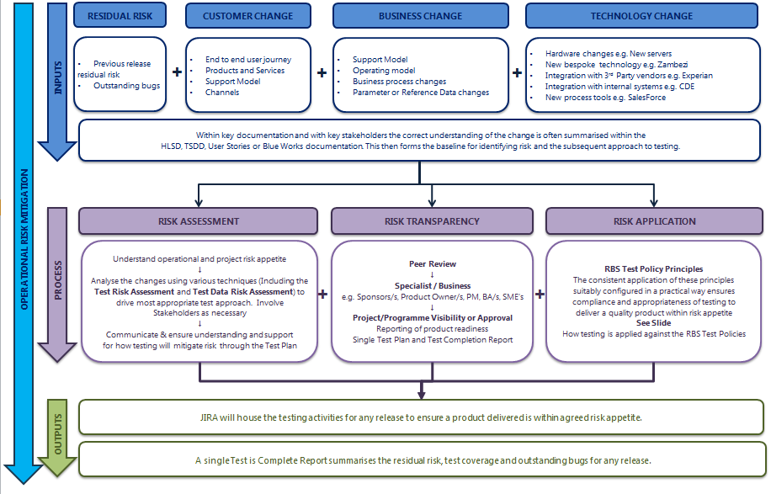

Risk Management
Outlines what inputs, processes and outputs are used when using test activity to inform residual operational risk across the release ahead of implementation

Slide 31
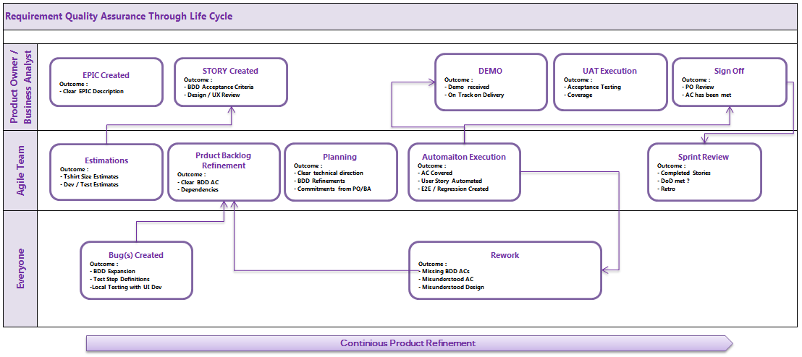
Requirement Quality Assurance Through Life Cycle

Slide 32
Release & Story Standards
The following Release & Story Standards are guidelines on what the team deliver to ensure that consistency in quality is adhered to across the different agile teams.
Each individual agile team will create, own and maintain their own definition of ready and done that are a extension of the below standards. All these can be found under the URL below.
Release Stage Gates
Stage | Description | Owner
Production Candidate Ready | FINAL PRODUCTION BUILD READY. All issue types for release labelled with fix version and set to done | Release Manager
Release Candidate Ready | NO DEVELOPMENT ON NEW FEATURES. Developers articulate release baseline and create a release branch for release testing | Project Manager
Release Testing | ONLY BUG FIXES FOUND IN RELEASE TESTING INCLUDED IN BUILD. Release testing consists of Regression, Performance, Security and Operational Readiness. | Quality Manager
Release & Story Standards
Pre-Sprint | Sprint | Release Testing
Developing a story have you thought about? | Completed a story have you thought about? | Product is ready for release only when
Is the description in a understandable state for the team? | All the acceptance criteria has been met | Code is completed and fully tested
Is the acceptance criteria understandable state for the team? | All business analyst / product owner tasks and standards are met | No outstanding defects
All upstream/downstream dependencies and do they require a change? | All development tasks and standards are met | All governance stage gates are completed
All upstream/downstream dependencies do they require testing support? | All Quality tasks and standards are met | All knowledge transfers have been complete (Business and all Support teams)
All testing scenarios captured? | Product owner has signed off the story | Any build/deployment/configuration discrepancies have been documented/communicated (Approval required to process – Go/No go)
Story Standards – This includes an in depth checklist that highlights the different standards and polices that need to be adhered to within NatWest/RBS.

Slide 33
Testing Tools
Management tools | Overall Test Tools | Unit test tools | API tools | Functional tools | Automation tools | SVP tools | Security tools | Accessibility tools
JIRA Issue management. One big action list. Confluence Overall heat map & project information | Physical Machines Production like test machines | SonarQube Unit Test Coverage, Bugs and Code Smells (MS Developers) | SoapUI API testing framework POSTMAN Manual API testing tool Swagger Aides in development and documentation for API | Git Bash Bash emulation to run Git from command line Snipping Tool Screen shot application | BDD Framework Testing framework Java Programming language IntelliJ IDEA/Eclipse IDE for Java development Selenium WebDriver GUI Automation Cucumber BDD framework Bitbucket (Stash) / GIT Code management system Team City Continuous Integration or Build Runner | Jmeter Performance Testing - system behaviour and performance under load | CheckMarx Static code analyser identifies security vulnerabilities OWASP ZAP Dynamic security vulnerability tool | AXE Browser extension developer tool for accessibility.

Slide 34



Test Data Mining Process
Data Team will mine/create the data in an automated and manual way
Identify Test Data using
BDD, UserStories and
Confluence link to data
Sources
Load the Data into Ulster
Sanity
Test & Confirm the
Environments
( Lower
Test availability to Ulster
Level Environment /
Test Team
Higher Level
Sanity Test from Ulster CP
Front End to confirm
Test Data Requirements will be met by Ulster Data Team by mining from Core and then set up in CDE
Mined test data will be verified against requirements by Data Team manually or using an automated script in SoapUI
Developers and testers use data as part of test execution in all environments
Lending DB is checked for accurate data update as part of test execution
Correct uploading of data to Sales Force is confirmed during test execution

Slide 35

Defect Management Process
Process Step | Action Points | Accountable
Raise | Discuss the defect with agile team members Confirm if it can be fixed immediately without a ticket being raised If ticket is required raise a ticket following the standard template given in confluence | Agile Team Members
Triage | Agile team confirms the testing priority of the defect Agile team to understand the root cause Formulate fix and fix time required | Agile Team Members
Prioritise | The product owner confirms the business severity of the defect The defects with highest priority & severity is assigned to relevant scrum team for fixing The defects which don’t demand an urgent fix are added to product backlog to be picked up in future sprints and aligned to a release | Product Owner
Fix/Retest | The bug should follow the agile team operating model, meet the teams Definition of Done, all tasks and standards are adhered to where applicable Attach executed test cases to the bug | Team accountable for the application under fix
Close | Bug closure follows the template given in confluence The PO closes the bug after it is showcased at show and tell | Individual that raised the issue Product owner has final sign-off

Slide 36
4.0 Functional Testing
Test Approach
Functional Automation Testing
E2E Testing – Integrations
Regression Testing

Slide 37

Digital Testing Approach
For all digital releases the testing approach to be followed as Triangle Model of the Test Approach
NFT
E2E Testing + Regression Testing
Functional Automation Testing
Service Level Testing
NFT testing focus to conduct the full NFRs of the delivery
Jmeter based framework
PROD Regression will be run on regular basis to identify any impact to PROD Code.
E2E level testing focus to automate the full E2E scenarios of the delivery
BDD Cucumber, Selenium WD, Maven based framework
PROD Regression will be run on regular basis to identify any impact to PROD Code.
Functional level testing focus to automate the User Stories have been taken for the delivery
Page Object based Automation
BDD Cucumber, Selenium WD, Maven based framework
Service Level testing focus to automate the Microservices
PostMan, soapUI, RestAssured Frameworks have been used to perform this type of testing

Slide 38

Functional Test Automation Approach
Product Owner
UAT TESTING
DIGITAL TRANCHE
Ulster Release
R
E
L
E
A
S
E
P
R
O
D
Ulster Team Backlog – User Stories
DEV / ENV TEAM
BA, DEV
Estimations
+ BDD AC
Develop in DEV
Deploy into SIT
Defect Fixes + Redeploy to SIT
Deploy into UAT / NFT
PLANNING
Automation Preparation
+ Test Data
BA, TEST
Estimations
+ BDD AC
Automation Testing + Defects identification
Retest &
Regression
( Automation )
E2E Regression
Automation
NFT Testing
( Performance, OAT, Accessibility & Security)
1
2
3
4
5
6
TEST TEAM ( Functional, NFT & 3rd Parties)

Slide 39
Functional Test Automation Approach
1
Ulster Tester will create the BDD from User Stories and other functional documents and review with BA and Automation Tester
2
Ulster Automation Tester will start to prepare the Test Automation in collaboration with UI Developers locally . The Data team to setup the data in the Ulster Environments.
3
Ulster Tester will execute the Test Automation in QA Environment. Raise Defects. Will be aided by SME for script review and exploratory testing In Sprint. VDI firewall request to access SPA URL has been requested so SME Functional testers can help with code review and automated execution
4
Ulster Tester will execute the Test Automation in QA Environment of all E2E Acceptance criteria. Raise Defects.
5
Ulster performance NFT Tester will execute the NFT Testing in NFT Environment. Raise Defects.

Slide 40

Scrum Test Approach - Detail
Story refinement completed according to Definition of Ready BDD Acceptance criteria written in collaboration with Manual Tester/Automation Tester/BA Automation coding initiated as per US in a sprint Downstream / Upstream change impacts identified Downstream / Upstream testing impacts identified Review and understand the planned scenarios for sprint n | Manual/Automation script execution Agile team to triage bugs during sprint and PO prioritise accordingly Agile team to follow release & story standards Agile teams to follow individual teams DOR & DOD Include Unit and API tests as part of the development work Execute functional acceptance tests including targeted regression around functional change Re-test bugs including targeted regression Automate all functional acceptance test scenarios Execute exploratory testing Raise bugs (Non in sprint story related issues) Run nightly automation regression pack, maintain, review & triage accordingly Agile team identify new regression test cases for handover to regression team and seek sign off by BA/POs All testers attend required ceremonies Ensure that administration from DoD is completed Agile team to continuously test early Accessibility | BA/Business review the testing for requirements coverage and Acceptance E2E Regression for all components Regression team to have regular review sessions of regression pack Regression team to execute targeted regression pack along side sprint work Regression team to execute full regression pack before go live Run nightly automation regression pack, maintain, review & triage accordingly Agile team execute exploratory testing (Minimum 2 hours)
Security – Impact assessment completed for sprint n stories NFR to be refined with PO/BA SVP – Impact assessment completed for sprint n stories NFR testing dictated by TRA and BA NFR to be refined with PO/BA | Security – Analyse static & dynamic reports from sprint n-1 & raise bugs in backlog Accessibility – Analyse static report from sprint n-1 & raise bugs in backlog SVP – Continuously script and execute SVP test & raise bugs in backlog | Mobile and browser testing as defined in NFR Dcoument
In Sprint
Sprint
Post Sprint
Functional
Non Functional

Slide 41
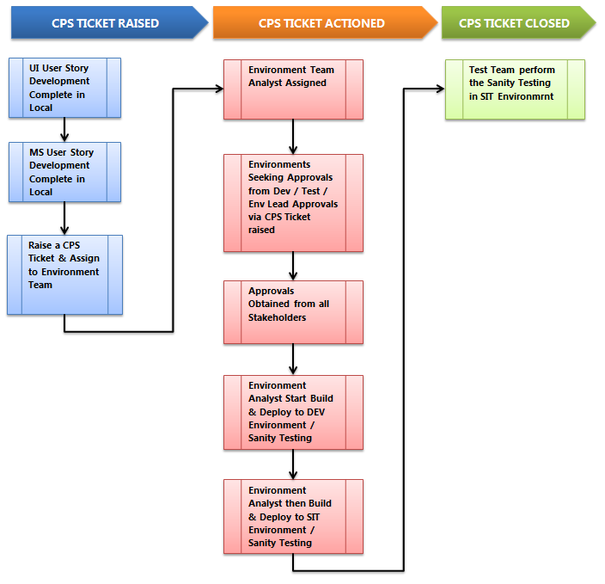
Test Environments – Deployments Process
* Same Process should be followed for NFT Code deployments.

Slide 42
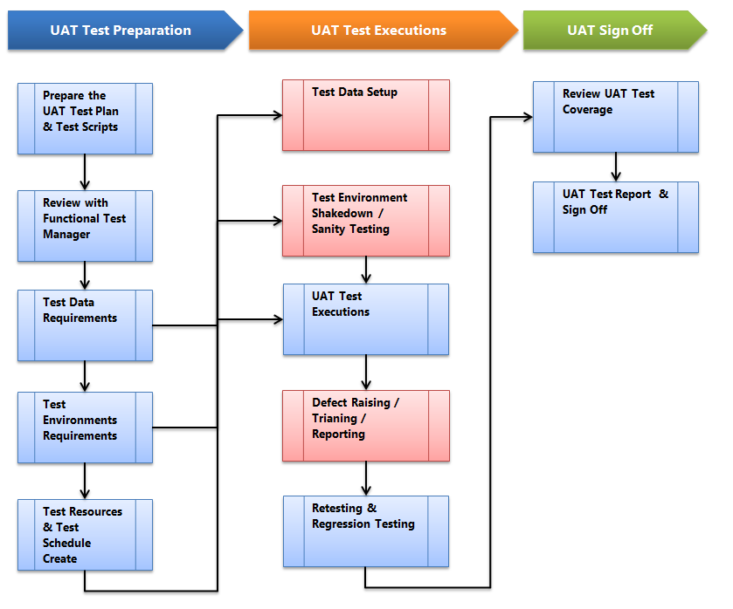
UAT Testing
Product Team has agreed to perform the UAT Testing
Functional Test Team will be providing all the support to the Product Team for the UAT Test Executions
Functional Test Team who will be running the Defect Triaging
Upon success of the UAT Testing, the Product Team will be providing the Test Report & Sign Off.

Slide 43
4.0 Non Functional Testing
Summary
Performance Testing
OAT Testing
Security & Pen Testing
Accessibility Testing

Slide 44

Non Functional Testing - Summary
Non Functional Test Phases in Scope for Digital Releases are as below :
Performance Testing
Operational Acceptance Testing (OAT)
Security & Penetration Testing
Accessibility Testing
NFT Test Types | Description | Accountable
Performance Testing (SVP) | Software Performance testing is type of testing perform to determine the system performance to measure, validate or verify quality attributes of the system like Responsiveness, Speed, Scalability, Stability under variety of load conditions. | Test Team via Shared Lending Performance Test team
Operational Acceptance Testing ( OAT ) | Agile team confirms the testing priority of the defect Agile team to understand the root cause Formulate fix and fix time required | Test Team via Infra team & 3rd Party Company
Security & Pen Testing | The product owner confirms the business severity of the defect The defects with highest priority & severity is assigned to relevant scrum team for fixing The defects which don’t demand an urgent fix are added to product backlog to be picked up in future sprints and aligned to a release | Test Team via 3rd Party Company
Accessibility Testing | This testing phase covers testing to comply with the Equality Act 2010 and ensure that those with disabilities and other access needs can use the system to complete the tasks it was designed for | Test Team via 3rd Party Company

Slide 45
Non Functional Testing – Performance
Test Planning
Work Load Model Creation
Results & Reporting
Test Creation, Execution & Validation
Input of non-functional requirements
Review design documents
Trend data to feed into performance activities
Business requirements
Delivery approach
Performance scope definition
Workload model
Capacity analysis
SLAs
Component, User journey, E2E performance validation
Static code analysis
Deep diagnostic
Root cause analysis
Supporting approach for production performance
Proactive capacity planning / sizing approach in production
Non-functional requirements
Channels

Slide 46
Non Functional Testing - OAT
Backup and Recovery
To prove the operation and integrity of backup procedures and restoration to an agreed recovery point either at the same site or an alternate site.
Change Implementation
To prove that implementation into the production environment will not adversely affect the integrity of the production services.
Change Back-out
To prove that the back-out of a failed change will be successful and will not adversely affect existing production services.
Component Failure
Shutdown and Resumption
To prove that the system can cope with unplanned outages.
To prove that essential maintenance can be performed without service disruption or within an agreed timescale.
Operational Support and Procedure
To prove that diagnostic information and documentation is relevant and of sufficient quality
Alerts
To prove that alerts are raised in the event of a component failure, error condition or if a threshold is breached.
Disaster Recovery
To prove that the services can continue operation at an alternative site after failure of the primary site.

Slide 47
Non Functional Testing – Security & Pen
Testing Requested
Pre-agreed security engagement schedule
Scope, primary & secondary objectives defined per engagement
Testing Execution
Supplier on-site for duration of execution
Supplier has required system access
Testing Reporting
NESI raised per engagement
Supplier engaged
Security Services Operations (SOC) informed
Defects raised directly into JIRA ( with support)
Summary report supplied at the end of engagement
Supplier access to scope, objectives, environment information, solution designs, previous runs, defect information & security policies
NESI updated with execution results
Continuous triage & defect closure calls with central security
Primary Objectives
Application Security Testing
Manual Testing
SAST
(Static Application Security Testing)
DAST
(Dynamic Application Security Testing)
IAST
(Interactive Application Security Testing)

Slide 48
Non Functional Testing – Accessibility
Timings:
This will be run every quarter months by 3rd Party suppliers.
Scope:
The assessment constitutes a WCAG2.1 Accessibility Audit based on the guidelines published by the World Wide Web Consortium.
The assessment also takes into account the Group Accessibility Standards found on P3M
Method:
The following test techniques and tools will be used during the evaluation:
Use of AXE to conduct lower level environment Testing
Use of JAWS (screen reader) version 17.0 to complete typical tasks
Expert reviews
Review to test a set of Heuristics about accessible usage; for example:
Navigating without a mouse, just using the keyboard
Altering the text size
Switching off cascading style sheet(s), images, JavaScript and other scripting. Personalising the ‘Accessibility Options’ (available within Browser / PC Settings)
Cognitive walk-through to establish whether typical tasks can be completed
Conformance Inspection
Systematic review of each criterion, with reference to the underlying HTML code.
Automated tests to assess technical accessibility compliance
Use of Developer Toolbars and various Chrome toolbars and extensions
HTML validation tests
Use of colour analyser tool to check colour contrast
Prerequisites & Requirements
In order to carry out this work, we would need the following to be made available to Blazie Engineering:
A detailed (screen-by-screen and click-by-click) scope of the testing to be done.
All relevant account numbers, sort codes, work codes, supplier codes etc. required to complete the process.
A resource to be provide assistance if there are difficulties with the environment or with the described process.
A single point of contact to discuss any of the above.
Deliverables
The outcome from any Bankline accessibility analysis is a summary report on the outcome of the work completed.

Slide 49
Appendix – Approval Emails

